Slide 1
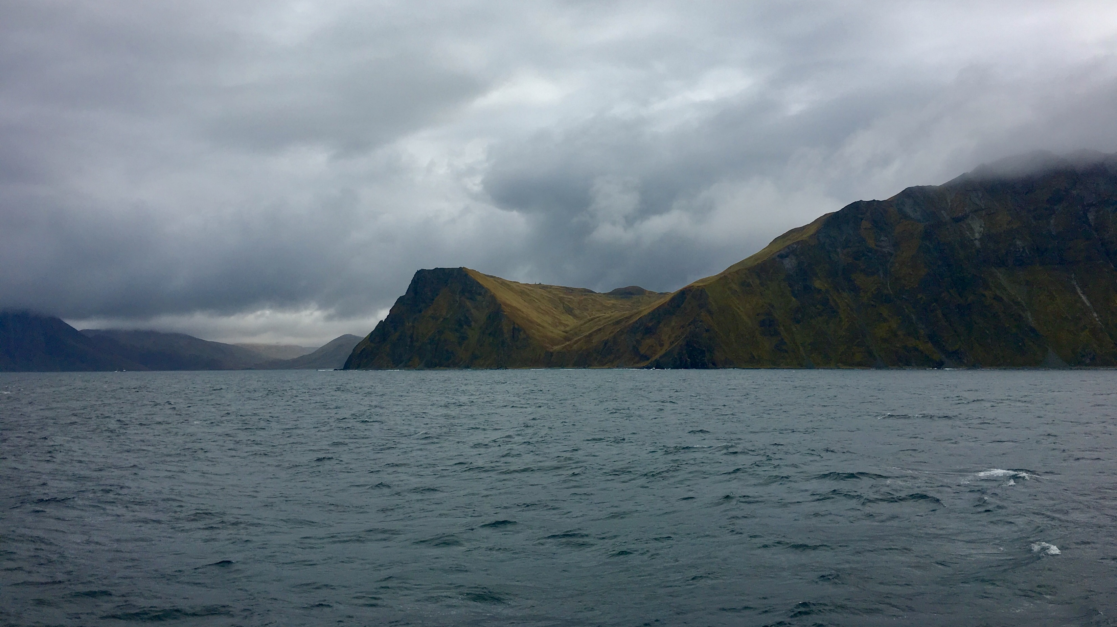
Variable Coefficient GAMs for Predicting Species Distributions
Rebecca Howard & Lorenzo Ciannelli

Slide 2
Bering Sea

Slide 3
EcoFOCI Data
Walleye pollock, Alaska plaice, flathead sole, yellowfin sole, Pacific cod, and northern rock sole
1988 – 2016
Late winter to summer
Notes:
- Black diamonds represent positive catches, red x’s represent zero catches

Slide 4
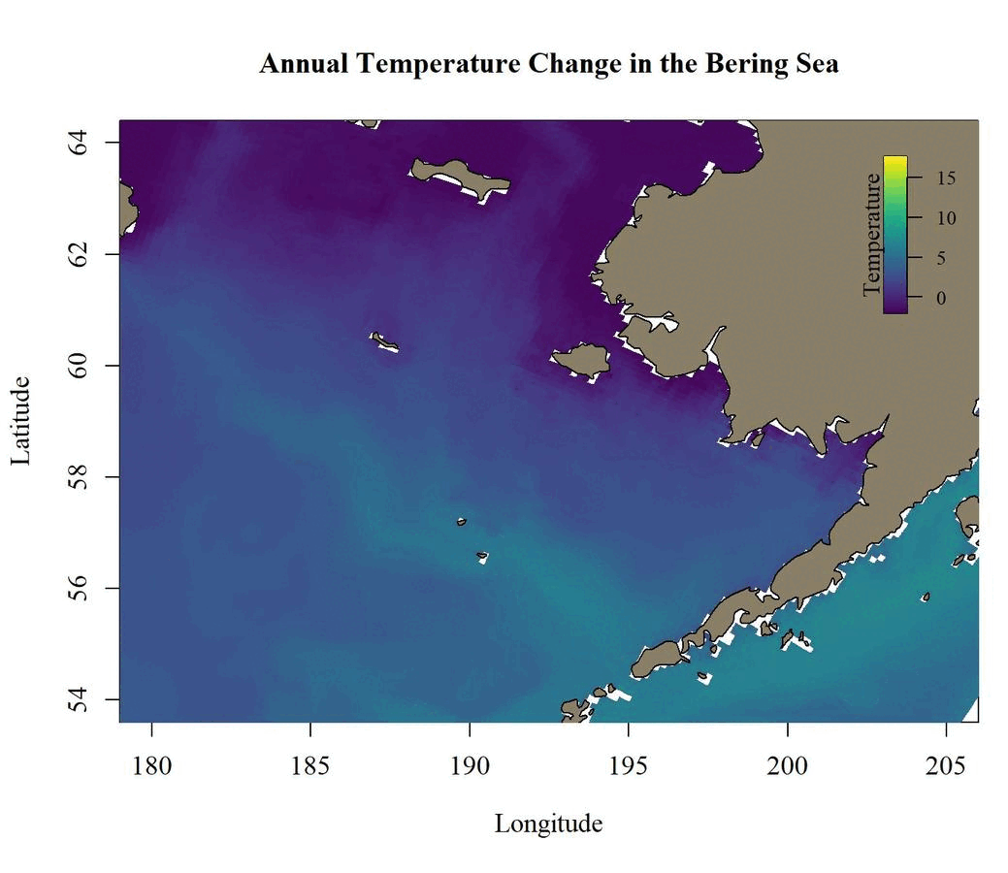
Bering10K Output
Regional Ocean Modeling System (ROMS)
Forecast and hindcast
CMIP6 emission scenarios
Notes:
Figure shows temperatures for every month in 2015
Did bias correction
Used three global circulation models (GFDL, CESM, MIROC) and two scenarios (SSP1-2.6 and the SSP5-8.5)

Slide 5
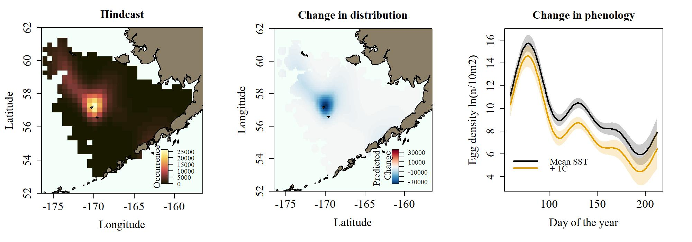
Model Parameterization
Generalized additive models (GAM)
Compared formulation containing variable coefficients for either day of year or location to formulations without variable coefficient terms
Akaike’s Information Criterion (AIC) for selection
Tweedie distribution with log link
Variable location: $catch+1=re\left(year\right)+s\left(location\right)+s\left(day of year\right)+s\left(SST\right)+s\left(SSS\right)+s(location, by=T)$
Variable timing:$catch+1=re\left(year\right)+s\left(location\right)+s\left(day of year\right)+s\left(SST\right)+s\left(SSS\right)+s(day of year, by=T)$
Notes:
Once the data and model output were ready for use, we looked at several different types of generalized additive models, or GAMs, in order to parameterize the models for each species and life stage.
The inputs into these models were the EcoFOCI observational data as the response variable and the Bering10K output for sea surface salinity and temperature.
Because we know that there are likely species that can move or change their time of spawning based on ocean conditions, we wanted to see if variable coefficient GAMs performed better than models that didn’t contain variable coefficient terms.
These variable coefficient terms allow either location of spawning or timing of spawning to vary with temperature, which we calculated as a mean value for each year from this box over the shelf for February through April.
This is different than the smooth term for collocated temperature, represented here as SST.
We also included year as a random effect, which was then zeroed out when doing the projections
To choose the best model, we used AIC, and we also took a look at what would happen with a 1 degree temperature change.
The figure shows an example of the results from this process, which produces a hindcasted or past distribution of a given species, in this case pollock eggs.
The left most panel shows the distribution while the middle and right panels show the difference in location and phenology if there were to be a 1 degree increase in temperature.
As you can see in this case, there is decline in pollock eggs with the increase in temperature.

Slide 6
Model Parameterization
Generalized additive models (GAM)
Compared formulation containing variable coefficients for either day of year or location to formulations without variable coefficient terms
Akaike’s Information Criterion (AIC) for selection
Tweedie distribution with log link
Species | Life Stage | Model | ΔAIC
Walleye Pollock | Eggs | location | 253
 | Larvae | location | 279
Flathead Sole | Eggs | location | 401
 | Larvae | location | 85
Alaska Plaice | Eggs | location | 391
 | Larvae | location | 233
Yellowfin Sole | Larvae | location | 237
N. Rock Sole | Larvae | location | 110
Pacific Cod | Larvae | timing | 141
Variable location: $count+1=re\left(year\right)+s\left(location\right)+s\left(day of year\right)+s\left(SST\right)+s\left(SSS\right)+s(location, by=T)$
Variable timing:$count+1=re\left(year\right)+s\left(location\right)+s\left(day of year\right)+s\left(SST\right)+s\left(SSS\right)+s(day of year, by=T)$

Slide 7
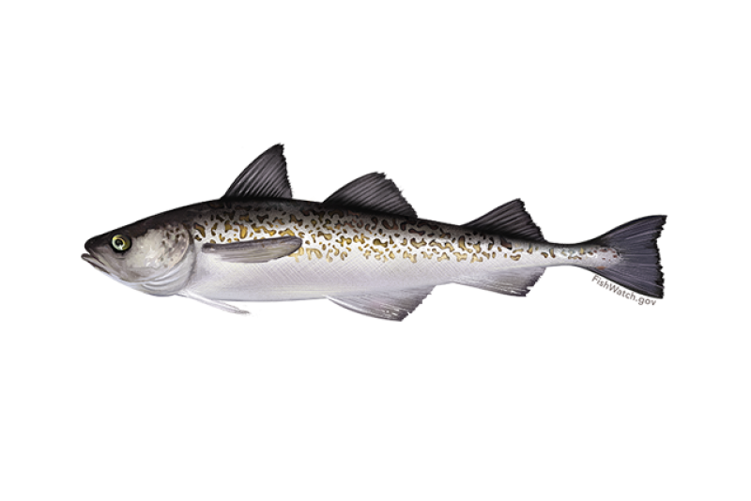
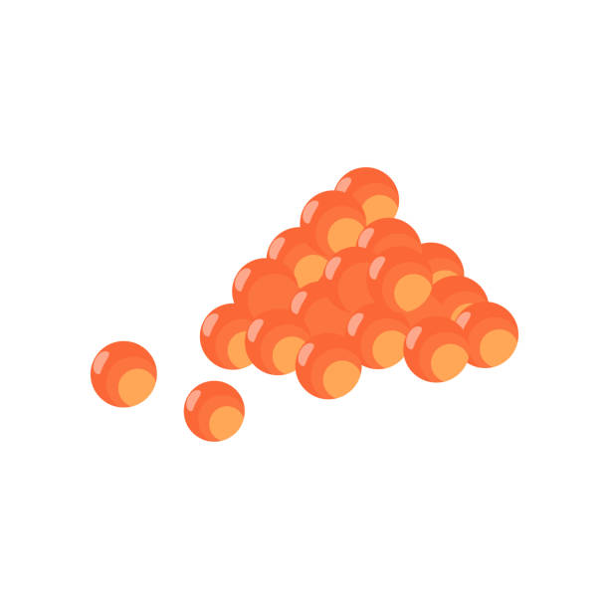
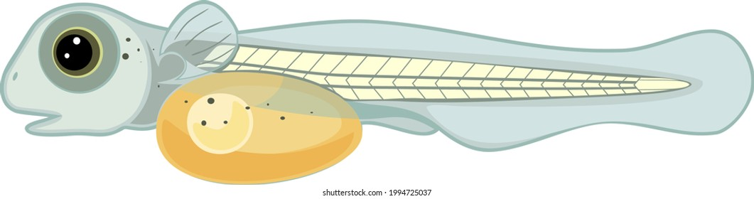
Walleye Pollock Eggs
Walleye Pollock Larvae
Notes:
- Pay attention to slight difference in temperature relationships

Slide 8
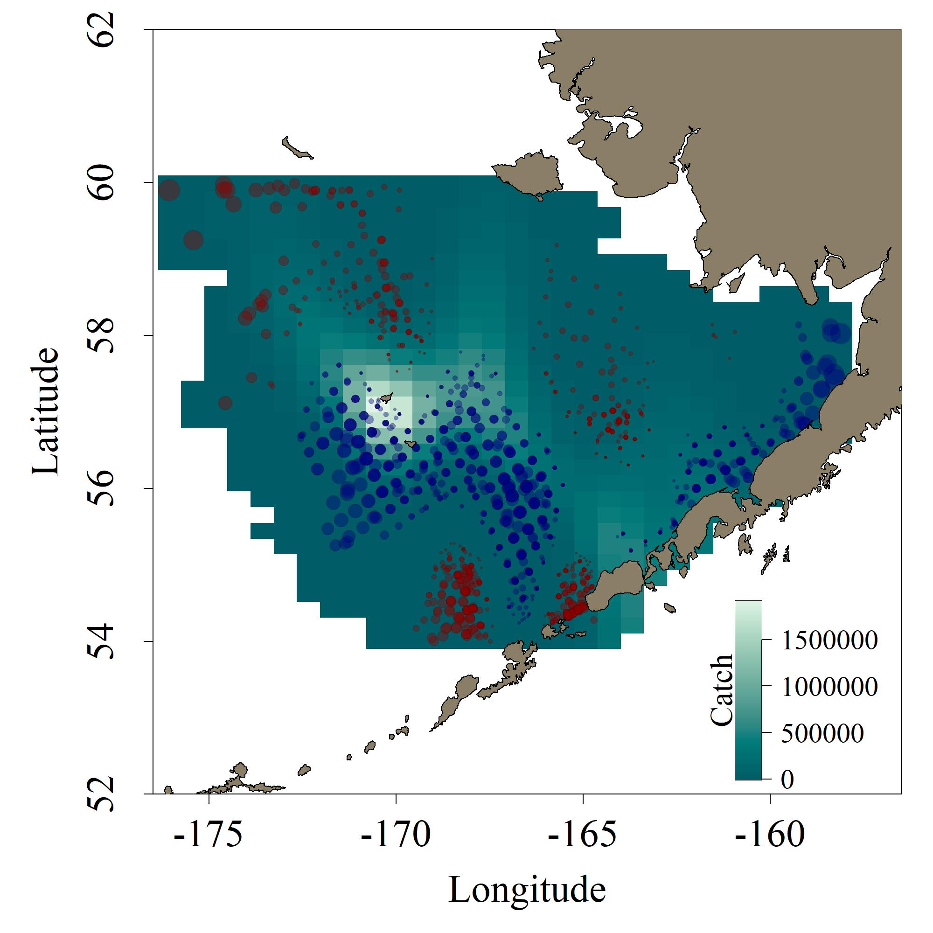
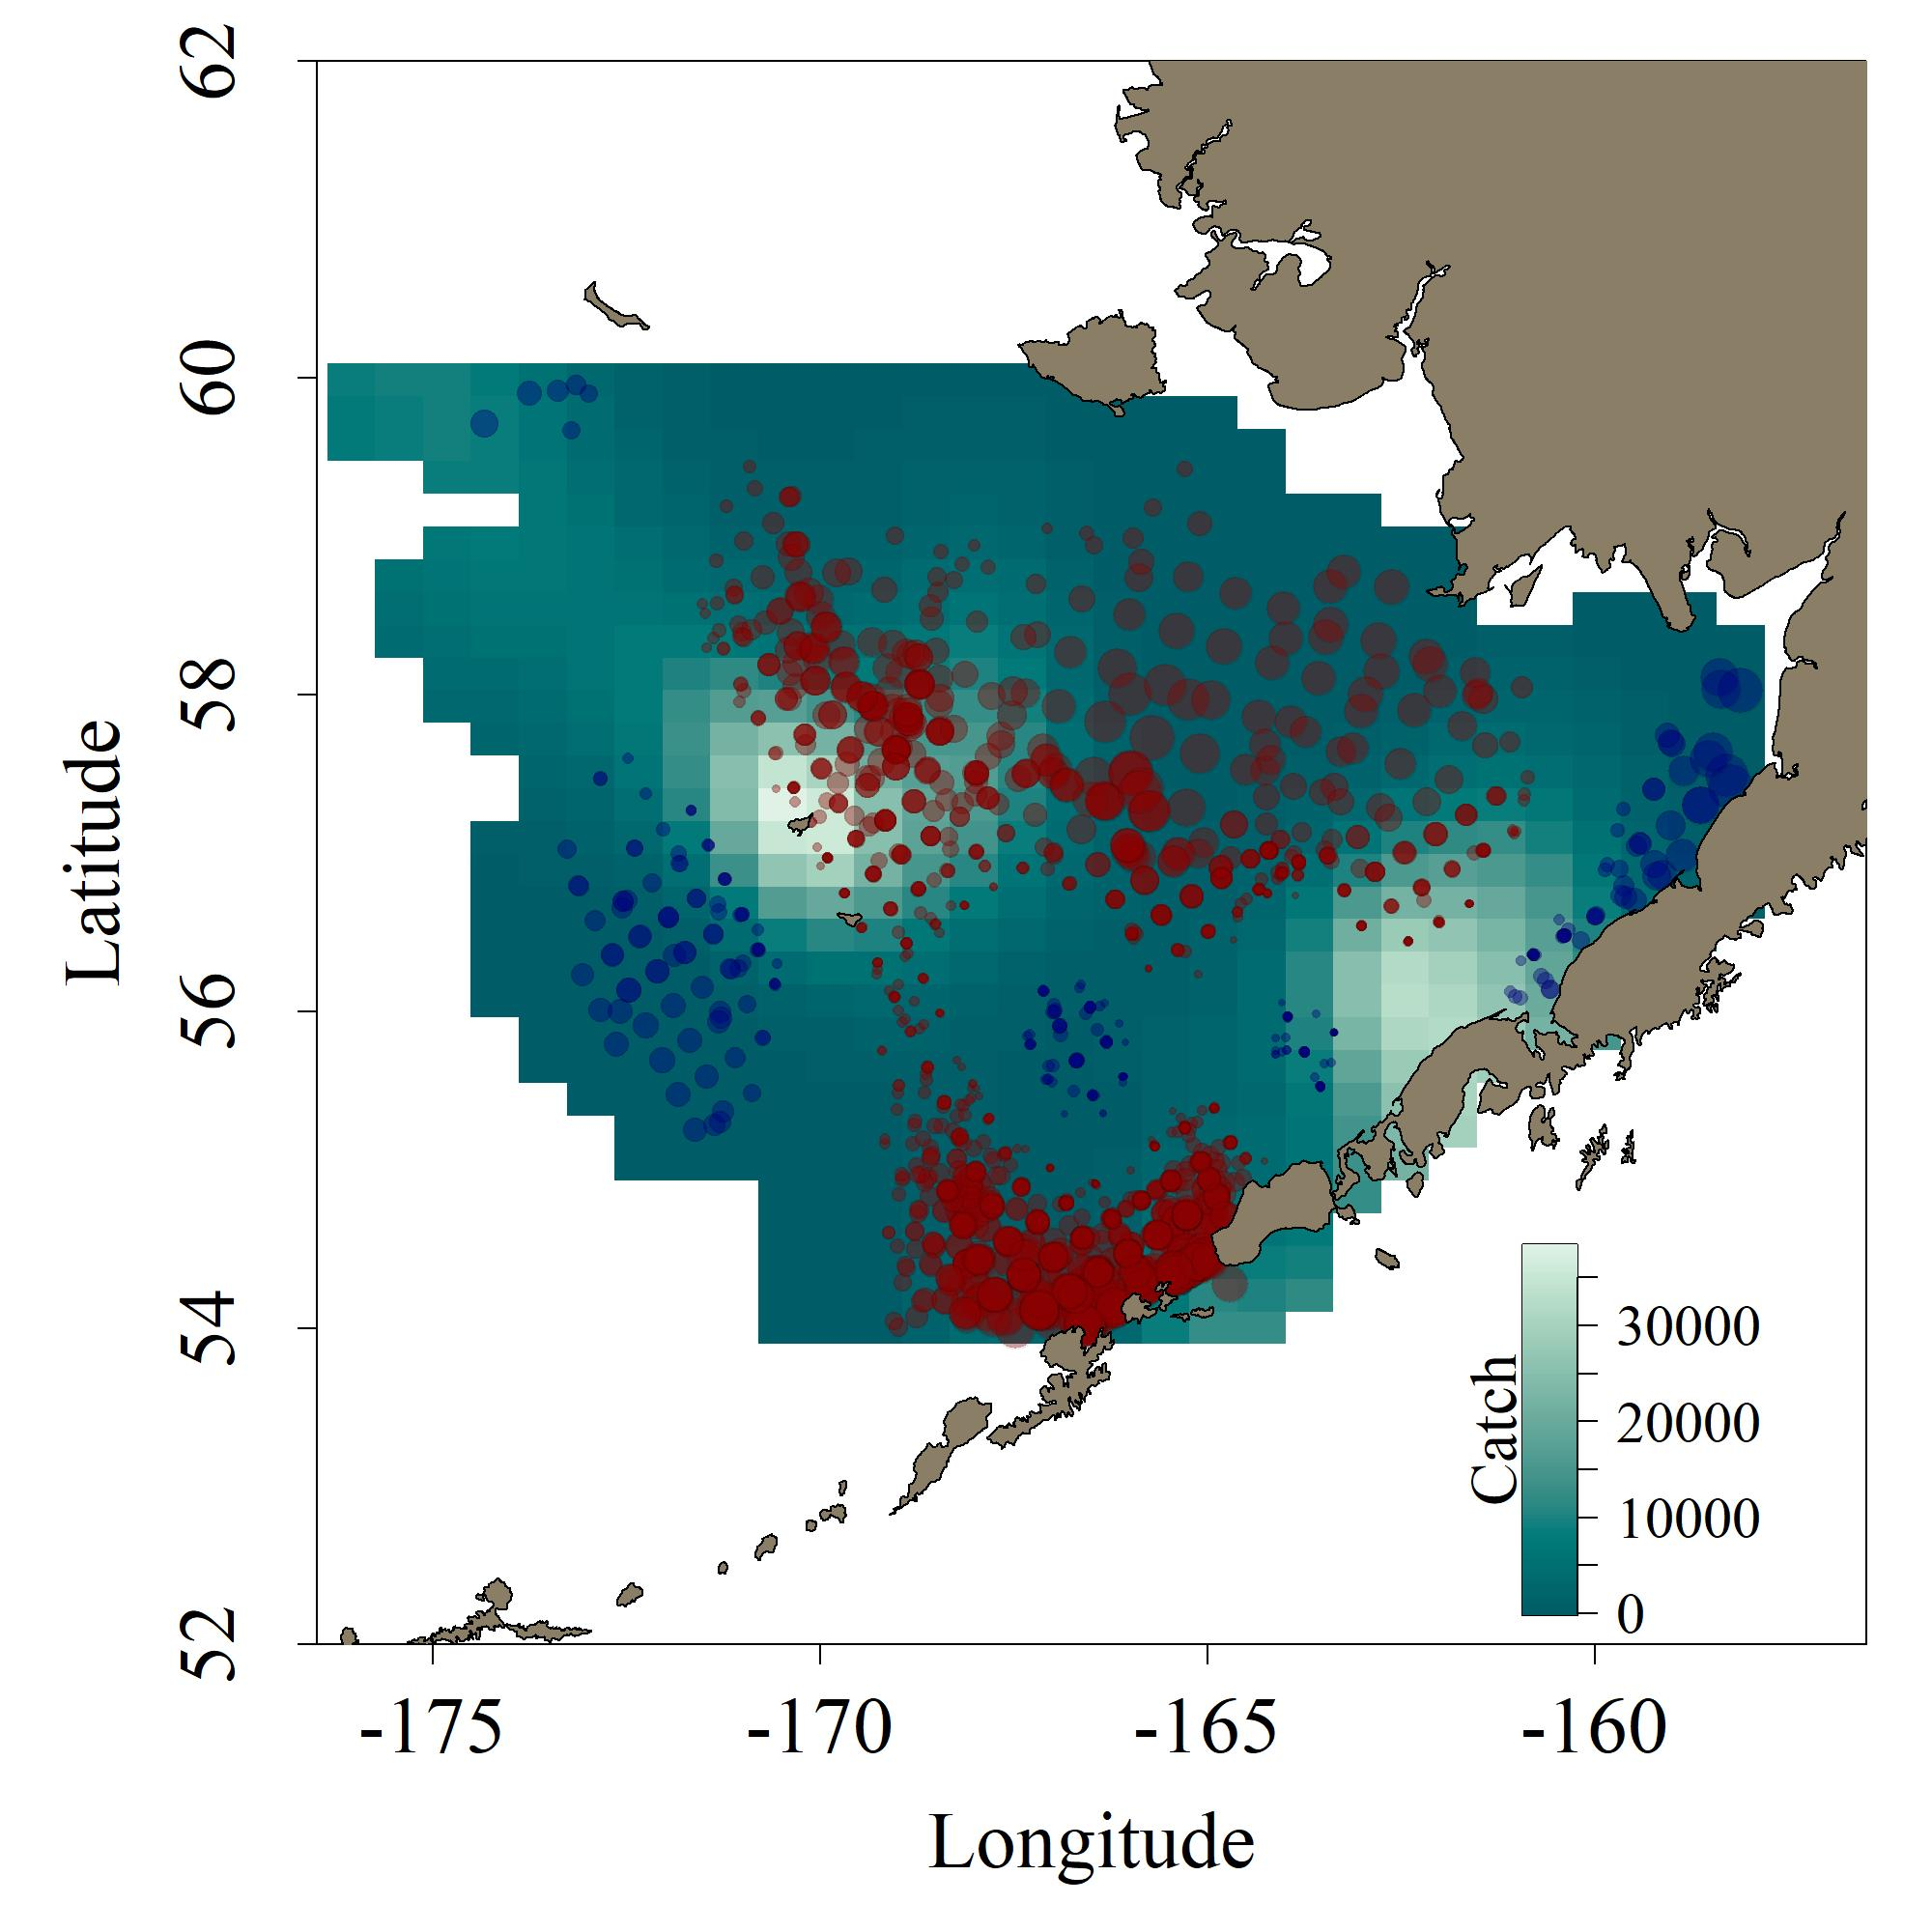
Walleye Pollock Eggs
Walleye Pollock Larvae
Variable location: $count+1=re\left(year\right)+s\left(location\right)+s\left(day of year\right)+s\left(SST\right)+s\left(SSS\right)+s(location, by=T)$
Notes:
Figures show the average distribution for pollock
Bubbles show the slope coefficient for only significant values, so essentially how eggs or larvae change with an increase in mean temperature
Blue bubbles show a decrease in eggs or larvae and larger size indicates more of a decrease
Red shows an increase, with size also indicating magnitude
Can see that in both cases, there are increases with increasing mean temperature on the inner shelf and near Unimak Pass
There are also decreases in similar locations, though to a greater degree for the eggs
One major difference is the increase northwest of pribilof islands for eggs

Slide 9
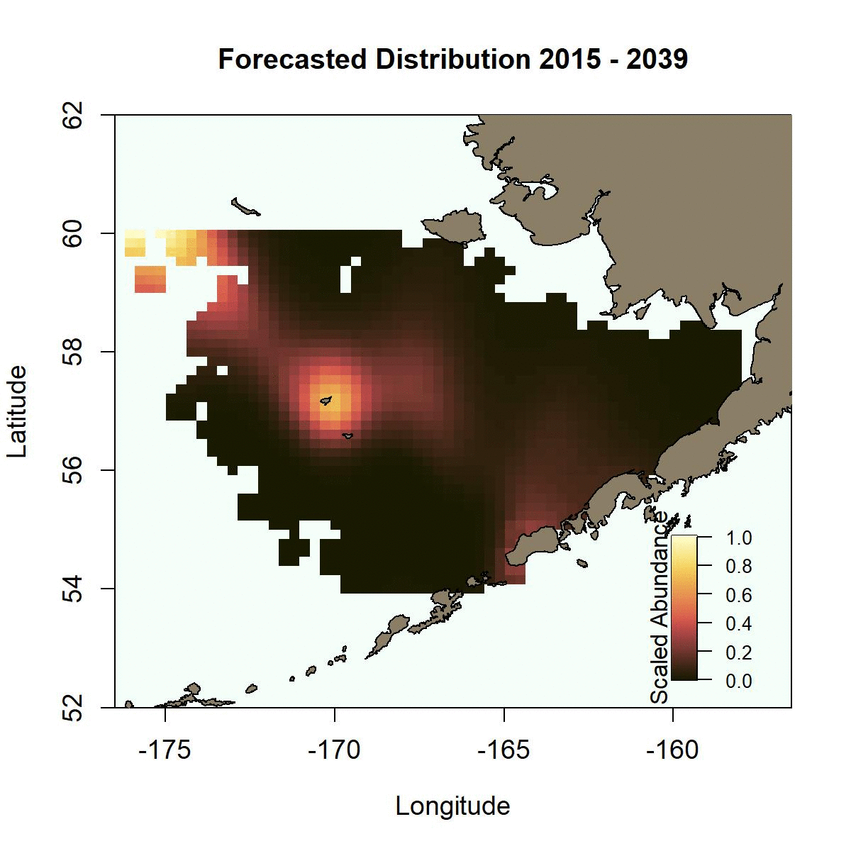
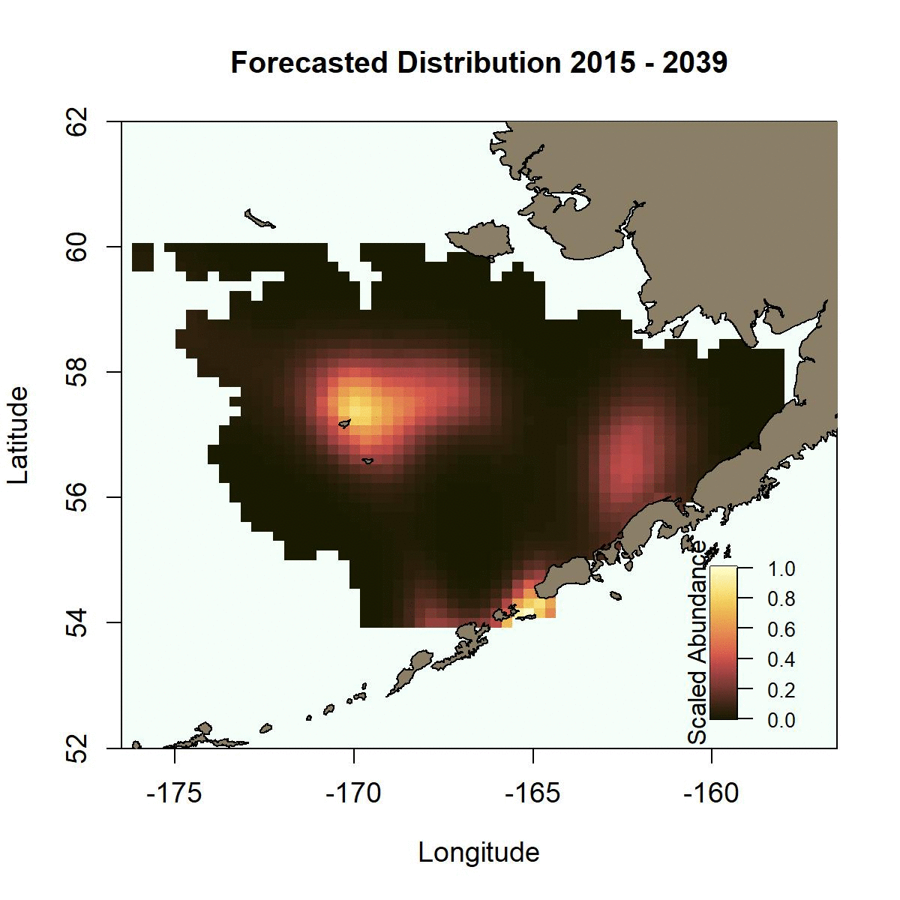
Walleye Pollock Eggs
Walleye Pollock Larvae
Notes:
These gifs show the change over the course of the next century in three time chunks
Possible reason for the movement northwesterly for eggs is the relationship with collocated temperature

Slide 10
West Coast

Slide 11
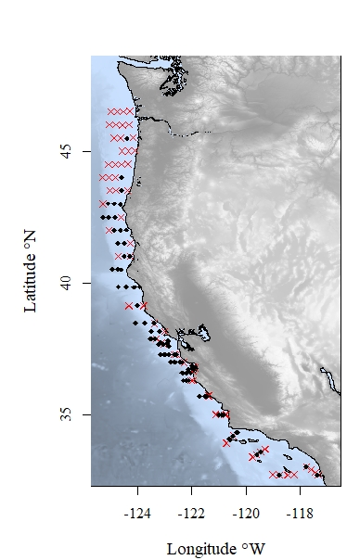
SWFSC and NWFSC Midwater Trawl Surveys
Pacific sanddab and Pacific hake
Began in 1983, expanded to coastwide in 2004
Sampling has occurred from late April – early July
Notes:
Contrasting life histories, using sanddab and hake
Right now using all of the data for preliminary analyses
Example of the data collection

Slide 12
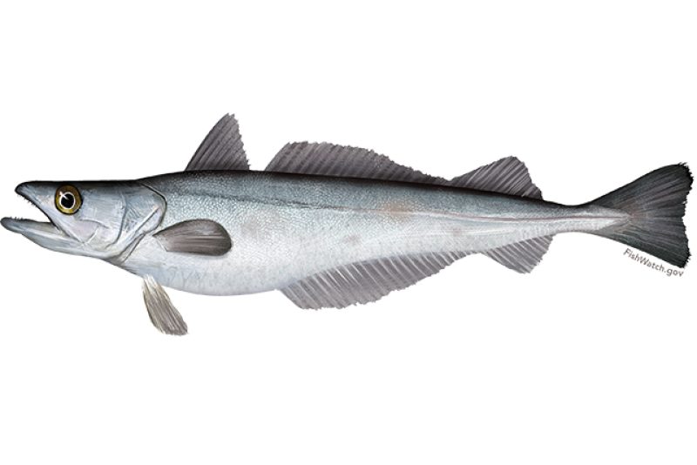
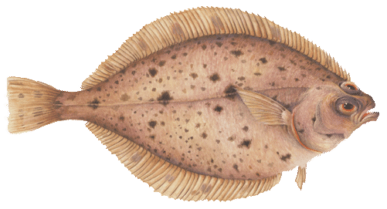
Pacific Hake
Pacific Sanddab
Spawn in late winter, spring off southern California
Important commercial fishery
Young-of-the-year (YOY) data available
Peak spawning in summer
Settle in late fall, winter
Some commercial catch
YOY and settled individual data available

Slide 13
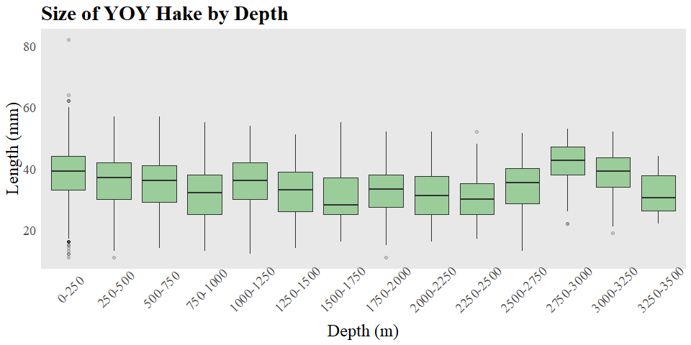
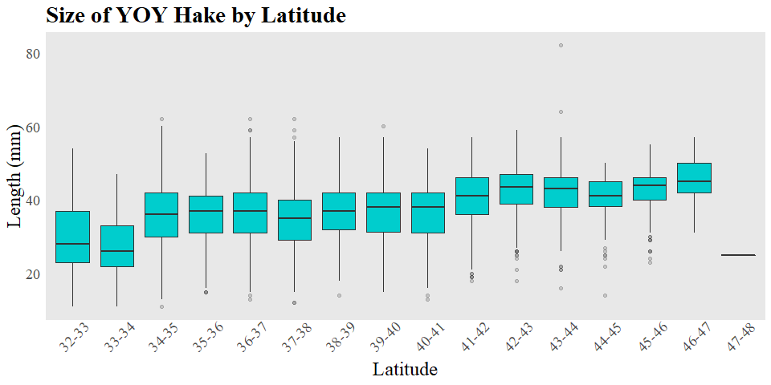
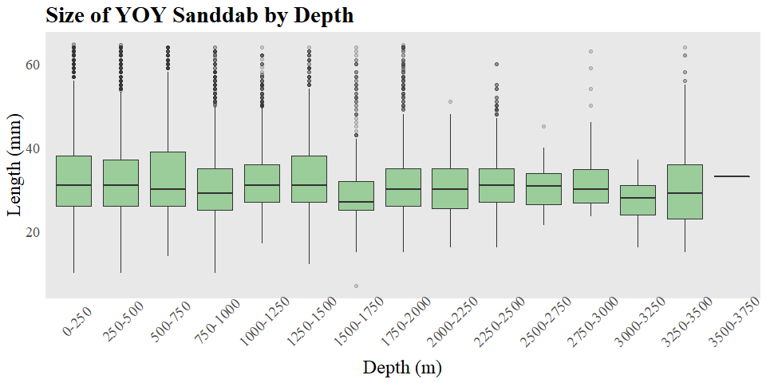
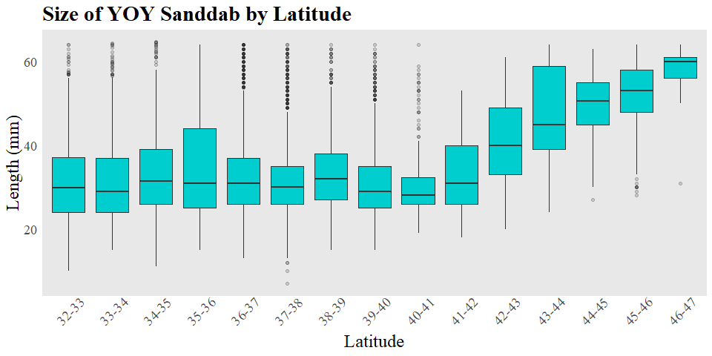
Notes:
Started by looking at sizes by depth and latitude bins

Slide 14
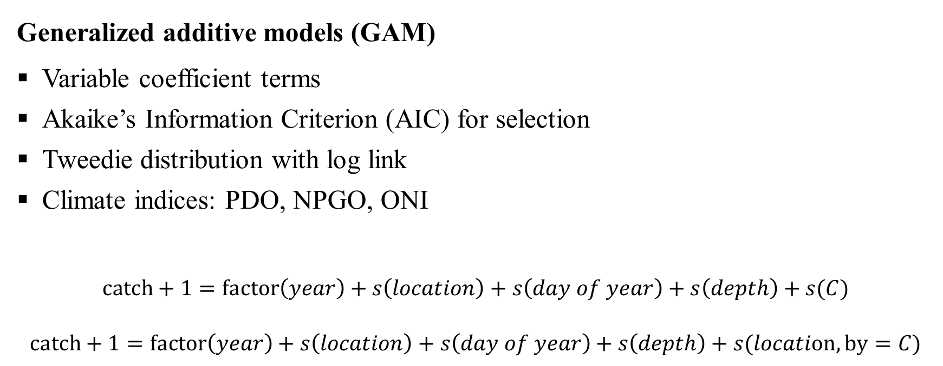
Methods
Generalized additive models (GAM)
Variable coefficient terms
Akaike’s Information Criterion (AIC) for selection
Tweedie distribution with log link
Climate indices: PDO, NPGO, ONI
$$catch+1=factor\left(year\right)+s\left(location\right)+s\left(day of year\right)+s\left(depth\right)+s(C)$$
$$catch+1=factor\left(year\right)+s\left(location\right)+s\left(day of year\right)+s\left(depth\right)+s(location, by=C)$$
Notes:
These variable coefficient terms allow location of abundance to vary with a given climate index, which we calculated as a mean value for each year from January through March.

Slide 15
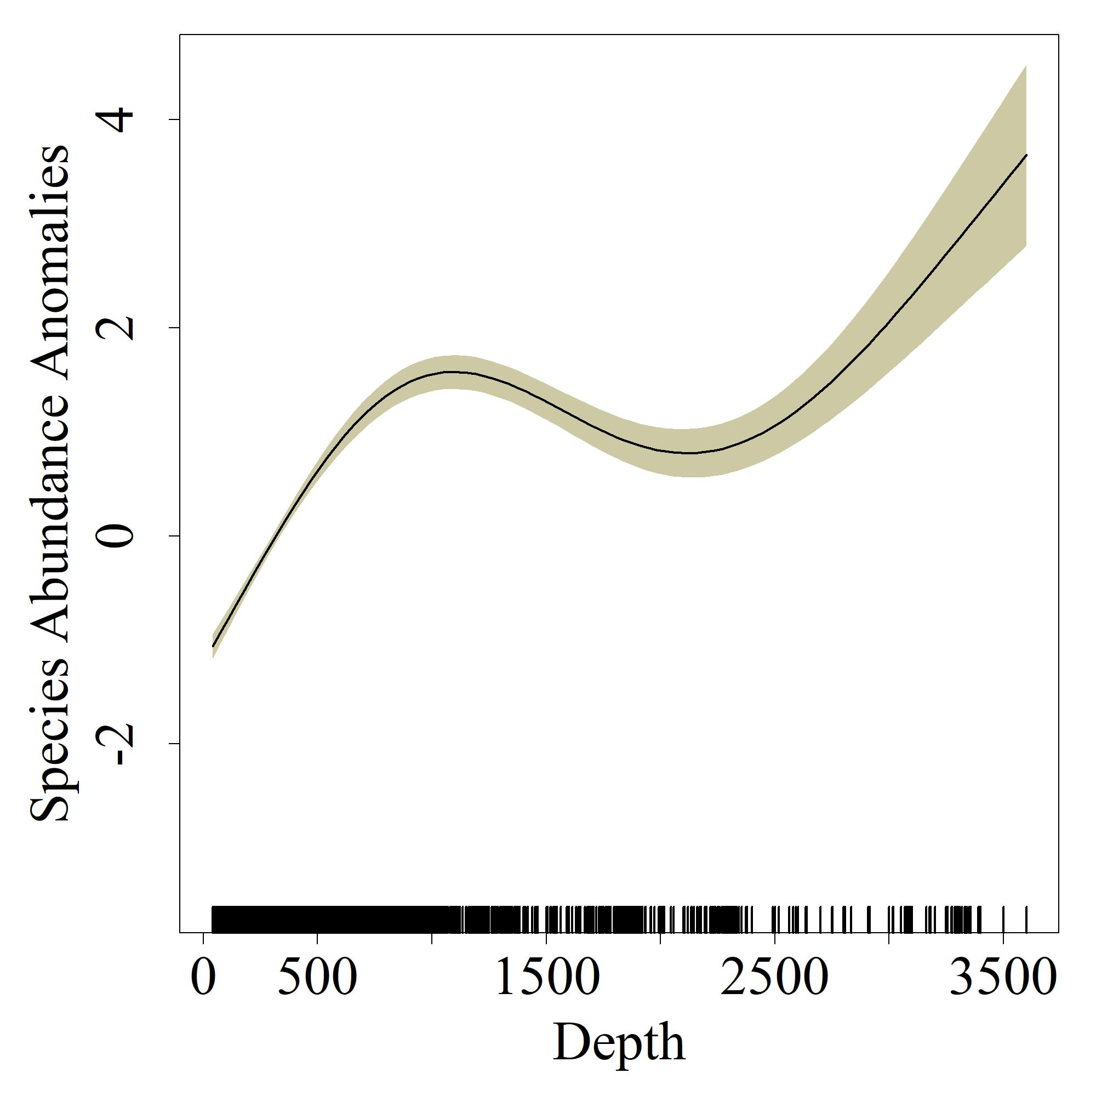
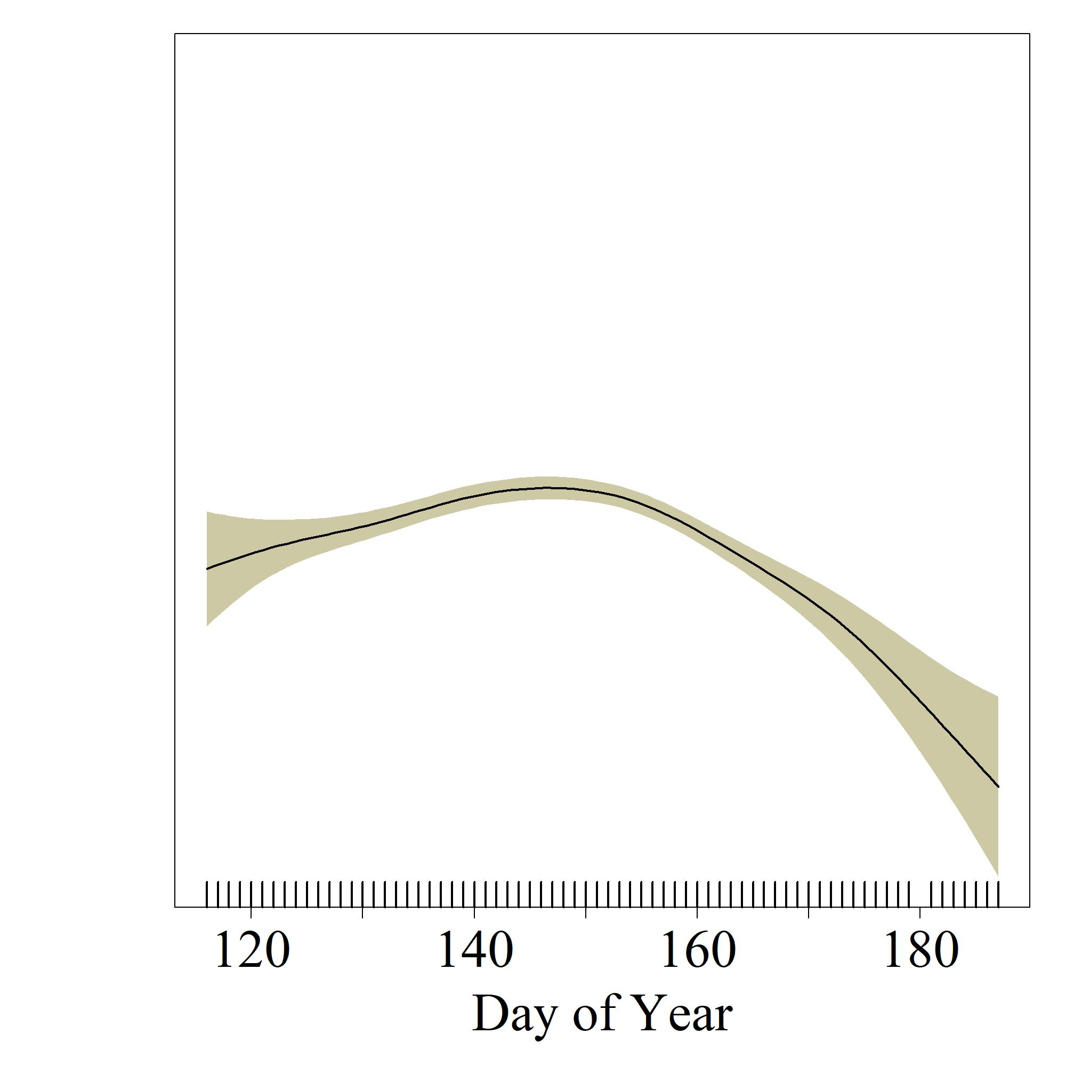
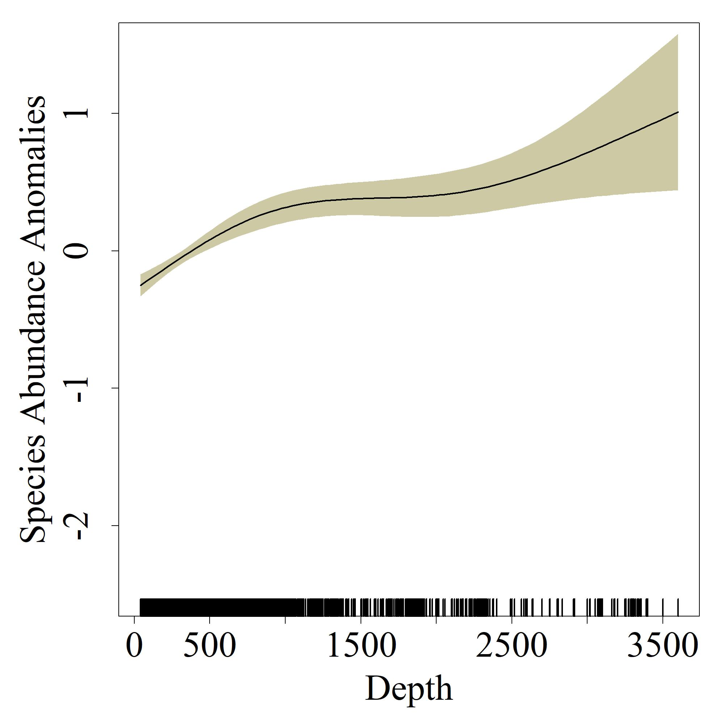
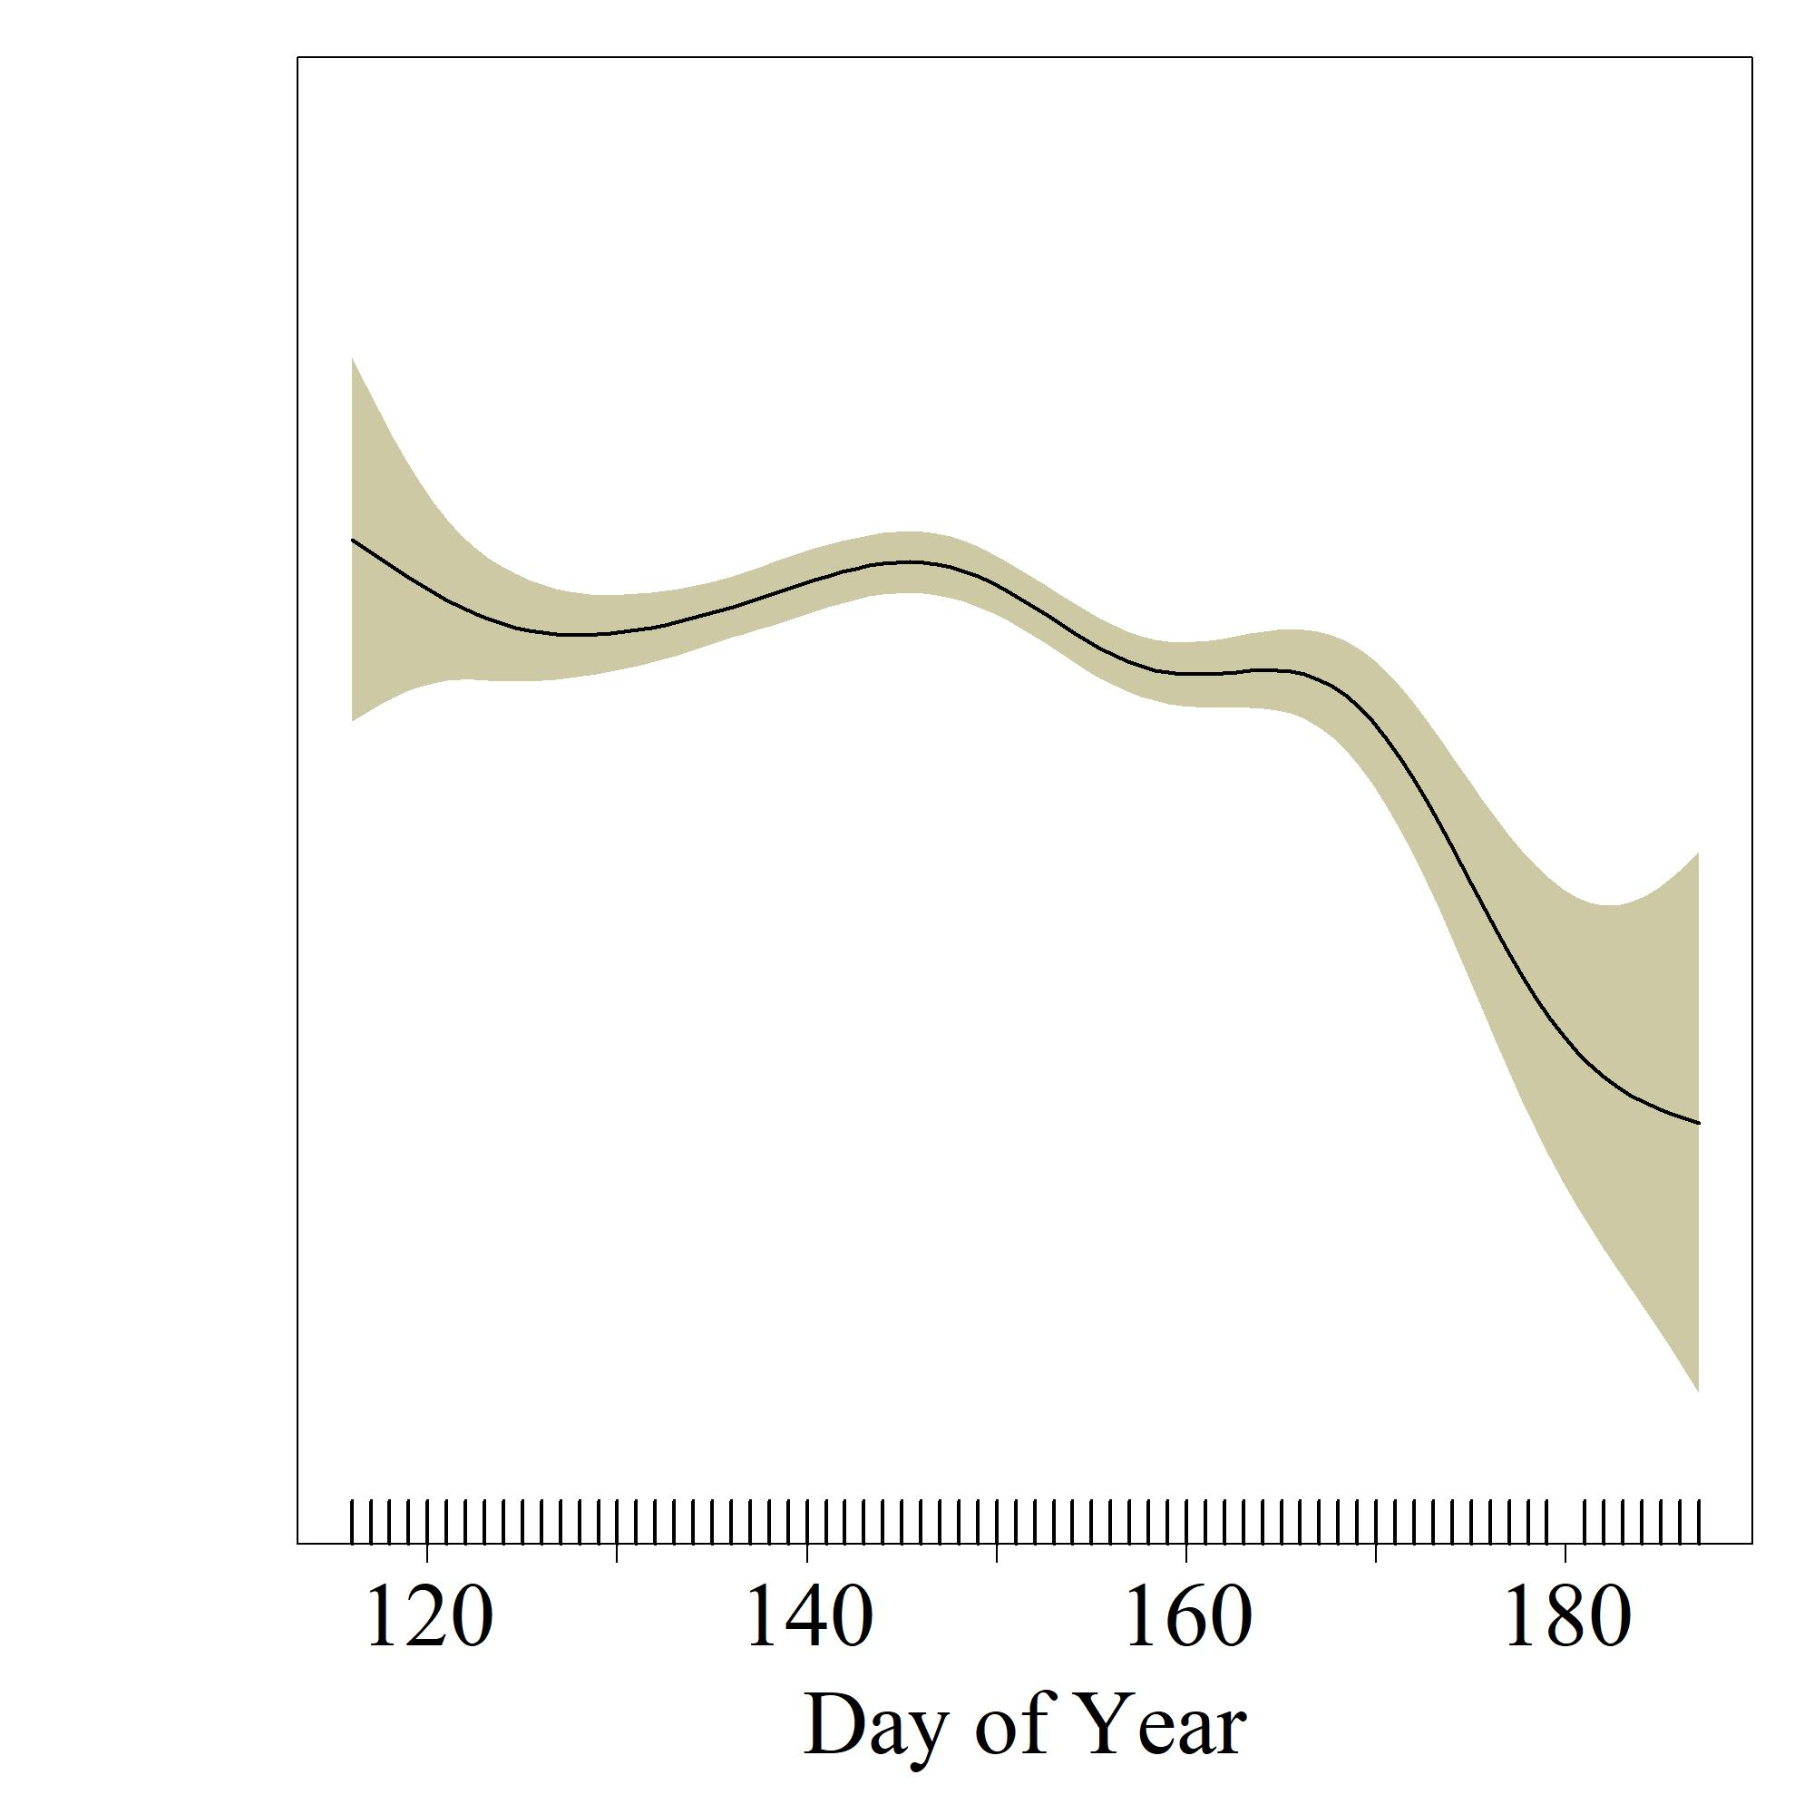
Pacific Hake YOY
Pacific Sanddab YOY

Slide 16
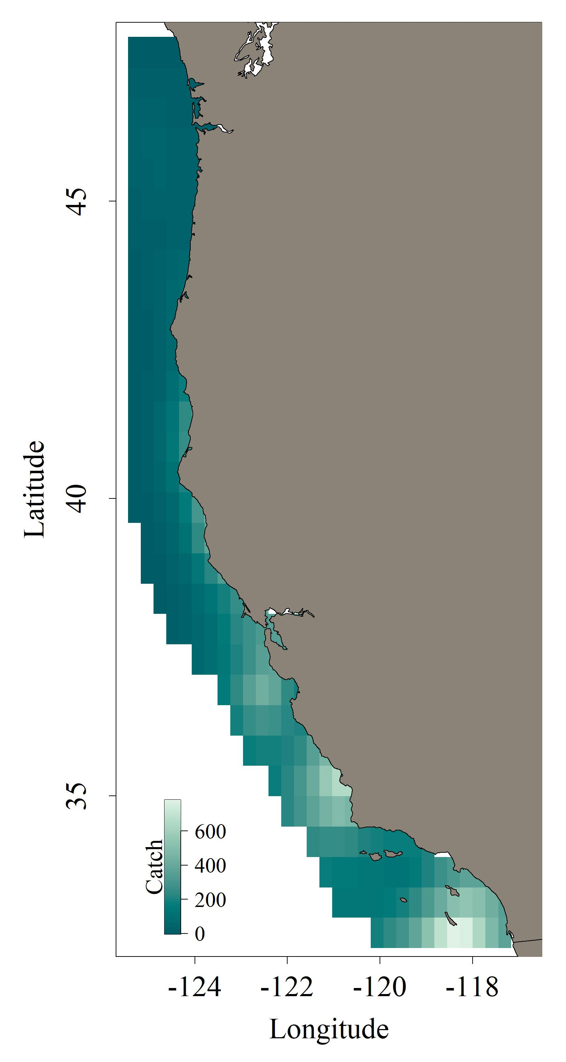
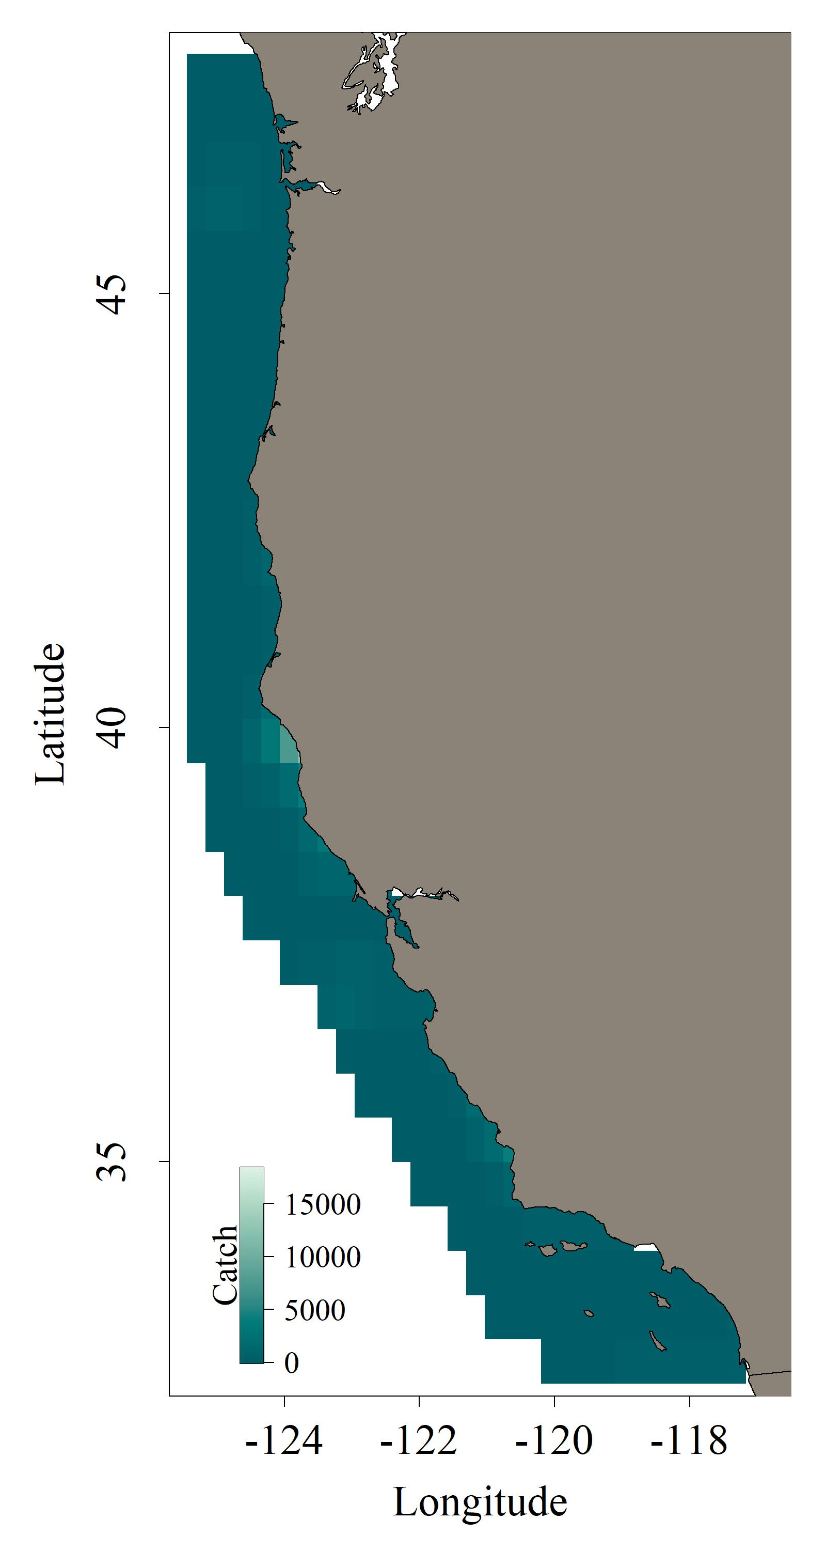
Pacific Hake YOY
Pacific Sanddab YOY
$$catch+1=factor\left(year\right)+s\left(location\right)+s\left(day of year\right)+s\left(depth\right)+s(location, by=NPGO)$$
Notes:
The best model included the variable coefficient term that used NPGO
These are the general distributions of hake and sanddab
For hake, largest abundance around 40 degrees
For sanddab, largest abundance are south of 40 degrees

Slide 17
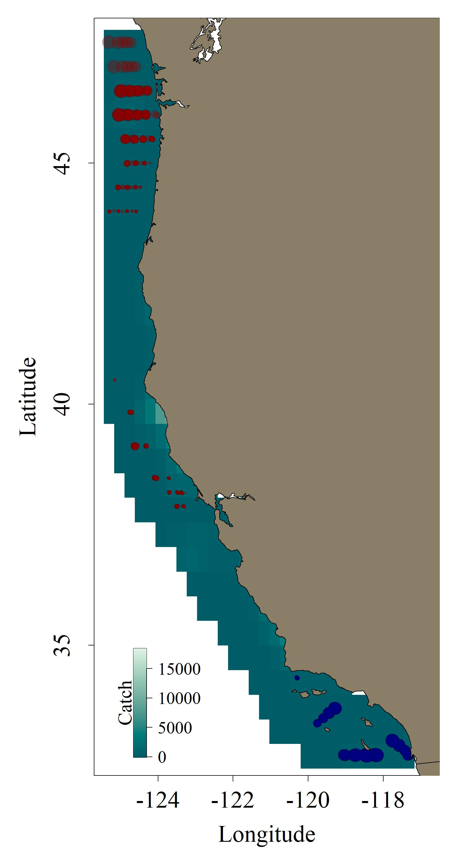
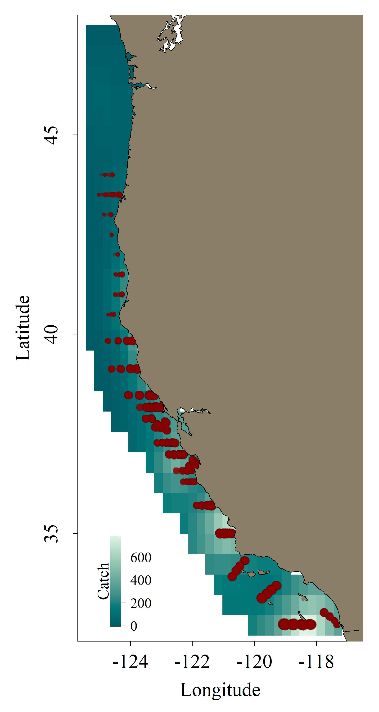
Pacific Hake YOY
Pacific Sanddab YOY
$$catch+1=factor\left(year\right)+s\left(location\right)+s\left(day of year\right)+s\left(depth\right)+s(location, by=NPGO)$$
Notes:
Same as before but now using NPGO
Blue circles mean decrease in hake or sanddab with an increase in NPGO
Red circles mean an increase in hake or sanddab with an increase in NPGO

Slide 18
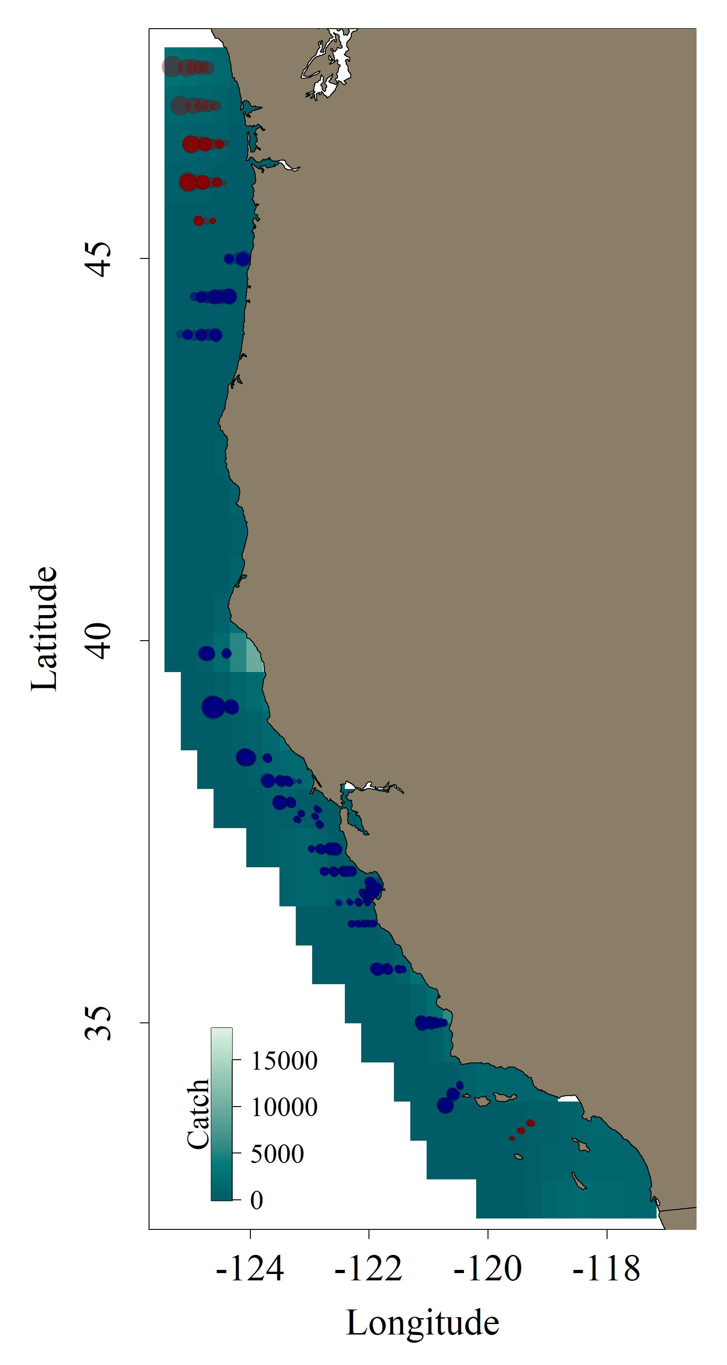
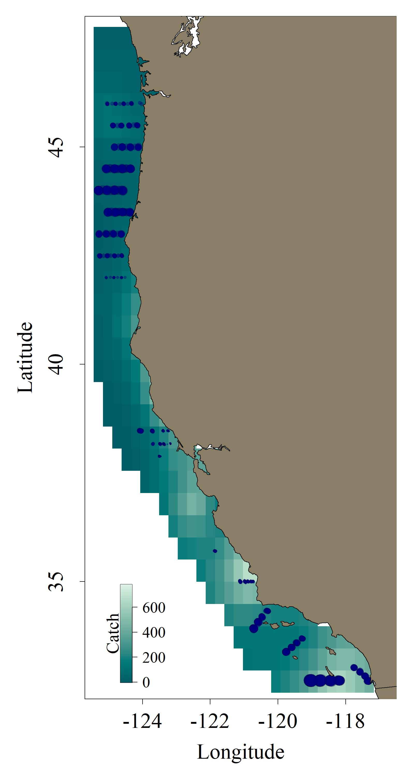
Pacific Hake YOY
Pacific Sanddab YOY
$$catch+1=factor\left(year\right)+s\left(location\right)+s\left(day of year\right)+s\left(depth\right)+s(location, by=PDO)$$
Notes:
PDO wasn’t the best model, but we wanted to look at the model that included the PDO variable coefficient term
We in general see a decrease in hake and sanddab with an increase in the PDO

Slide 19
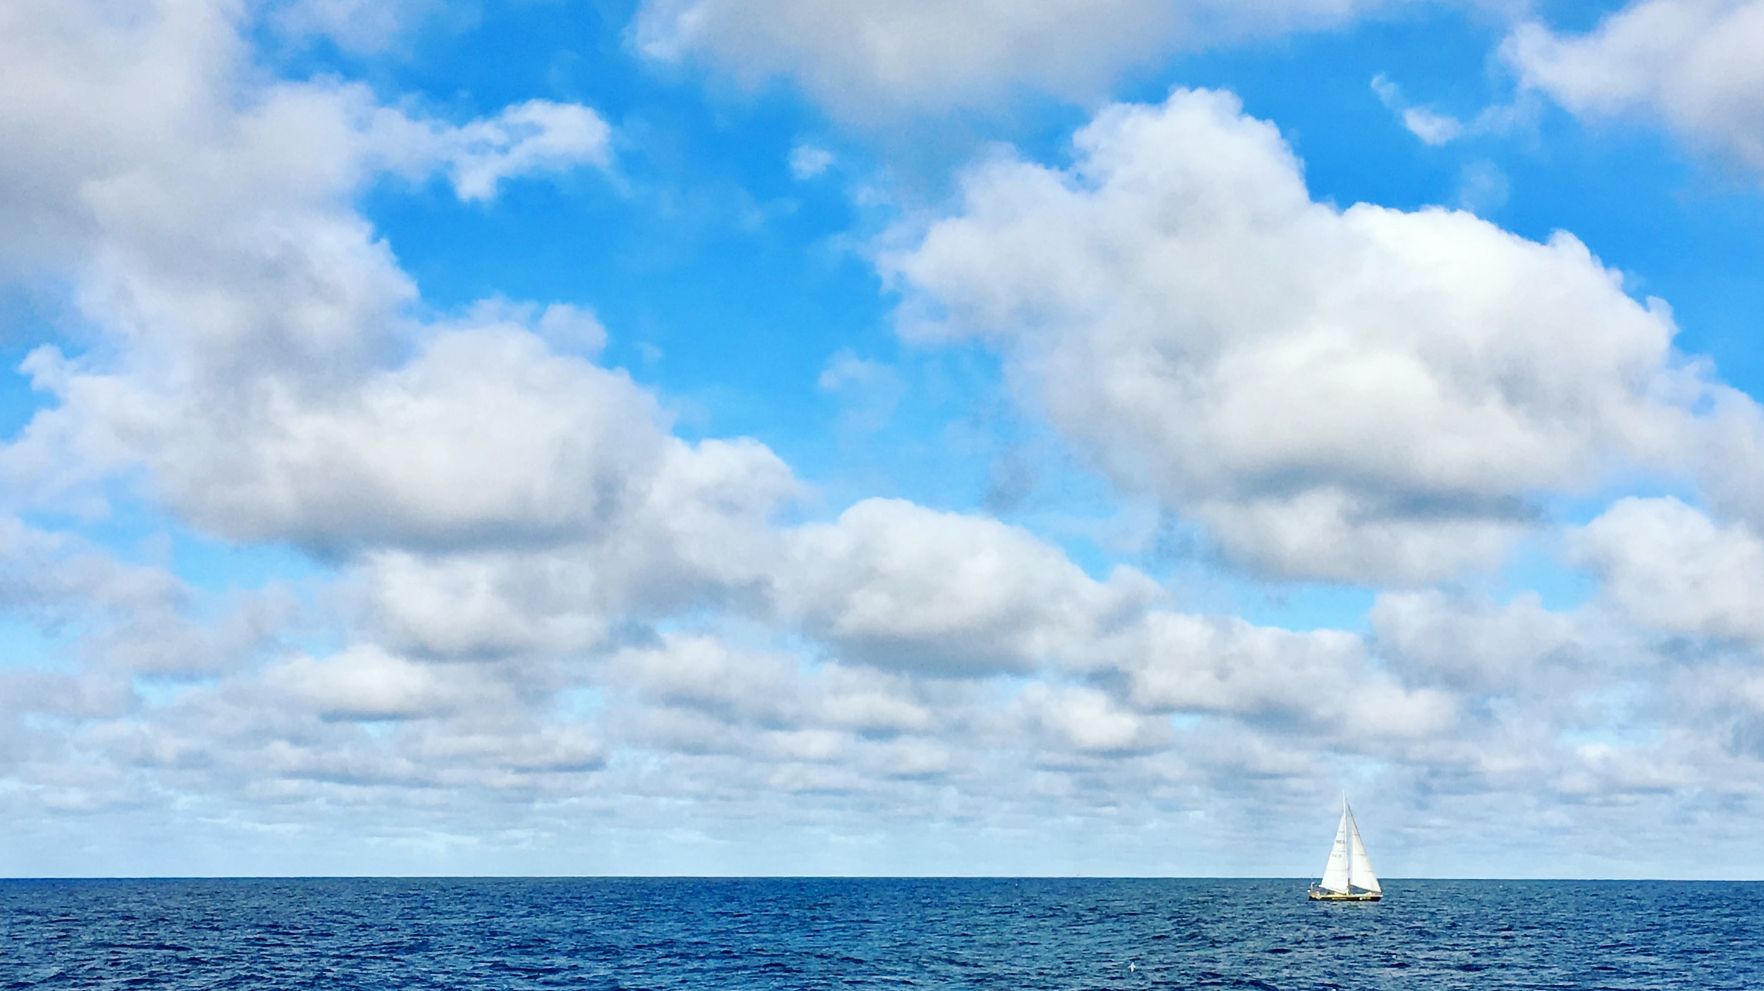
Future Directions
Incorporate CTD data
Separate by length groups
Additional survey data
ROMS

